Slide 1
Inhibitory Control in Language Games
Stephen Powell
University of Rochester
August 14th, 2015

Slide 2
Talk Outline
Prior Research
Experiment Game Design
Results for:
Adults on Mechanical Turk
Children at Bing Nursery School
Comparing Results to Prior Research
Future Directions MOOT SECTION???

Slide 3
Prior Research
Ad Hoc Implicature
Negation

Slide 4
Visual Stimuli

Slide 5


Slide 6







Experiment Phases
Implicature
Inhibition
Negation

Slide 7
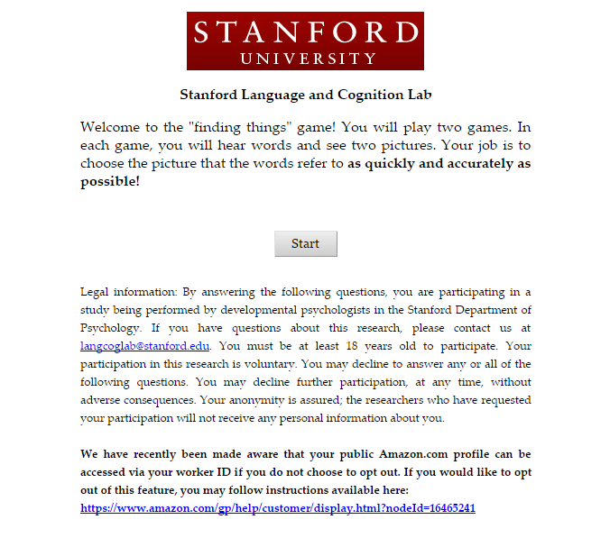

Slide 8
Adult’s Results
“General RT & Accuracy Data”
Correlation of Inhib to 1) Neg & 2) Implic

Slide 9
Kid’s Sample Video
FIND VIDEO THAT SHOWS KID PLAYING GAME

Slide 10
Children’s Results
“General RT & Accuracy Data”
Correlation of Inhib to 1) Neg & 2) Implic

Slide 11
Compare to Prior Work
Ad Hoc Implicature
Negation

Slide 12
Future Directions
Game was redesigned
Currently on Mechanical Turk
Reintroduce redesigned game to Bing
PERHAPS THIS SECTION IS MOOT WITH THE NEWEST RESULTS??? Ask Ann…

Slide 13


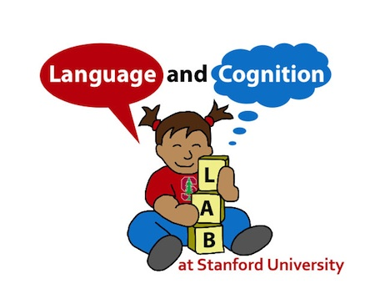

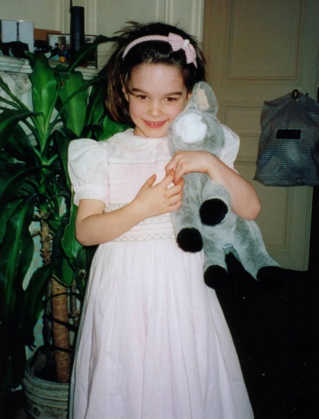
A Special Thanks To…
Ann Nordmeyer
Erica Yoon
Katherine Kaiser

